Slide 1

VEHICLE NUMBER DETECTION USING MATLAB
BY
T . DEEKSHITH (18245A0222)
P . PAVAN KALYAN (17241A02A3)
Y.UMAKANTH (18245A0224)
CH . HARSHA (17241A02B7)
GUIDE
P . SIRISHA
( ASSISTANT PROFESSOR )
GRIET

Slide 2
CONTENT
ABSTRACT
INTRODUCTION
components
CIRCUIT DIAGRAM
NUMBER PLATE RECOGNITION System
1. captured image using camera
2. extraction of number plate location
3. remove connected objects on border
4. character segmentation
INTERFACING OF RSPBERRY PI AND PI CEMARA
DATA HANDLING WITH MATLAB
RESULT
APPLICATIONS

Slide 3
ABSTRACT
Vehicle number detection is the most energizing and testing project theme from recent years. Number plates are of various shape, measure and furthermore have distinctive shading in various nations. In India the most well-known vehicle number plate utilized have yellow or white as foundation and dark as closer view shading. Right now proposed a framework for confinement of number plate for vehicles in India and fragmented the numbers as to recognize each number independently. The most part center around two stages; one is to capture pictures using pi camera by interfacing raspberry pi with matlab and second is to section all the number and letters to recognize each number independently. The project is created utilizing MATLAB.
This project work is actualized on the passage for security control of a profoundly confined region like military zones or region around top government workplaces for example parliament, Supreme Court and so forth., The created framework identifies the vehicles number to rebuff the individuals who doesn't keep the traffic manages by giving challan to their home.

Slide 4
INTRODUCTION
It is seen that the number plates of vehicles are fit as a fiddle and estimate and have distinctive shading in different nations. In this way, it is a difficult errand. It is hard to recognize the boundary of the Number plate from the vehicle pictures in outside scene because of shade of characters of the number plate and Background of the Number plate the inclinations of the first picture is received to identify applicant number plate districts. There are likewise calculations that depend on a blend of morphological activity, division and watchful edge finder. Tag area calculation comprise of steps like as Edge Detection, Morphological activity like expansion and disintegration, Smoothing, division of characters and acknowledgment of plate characters. Afterward, we are going to discuss each progression clearly.
This project requires interfacing of raspberry pi with matlab in order to capture images from pi camera which in turn connected to raspbeery pi. this requirement can be acheived by using hardware support packages which needs to be installed in matlab.

Slide 5
COMPONENTS
MATLAB software
Laptop
Number plates
Pi cemara
Raspberry pi MODEL 3B+

Slide 6
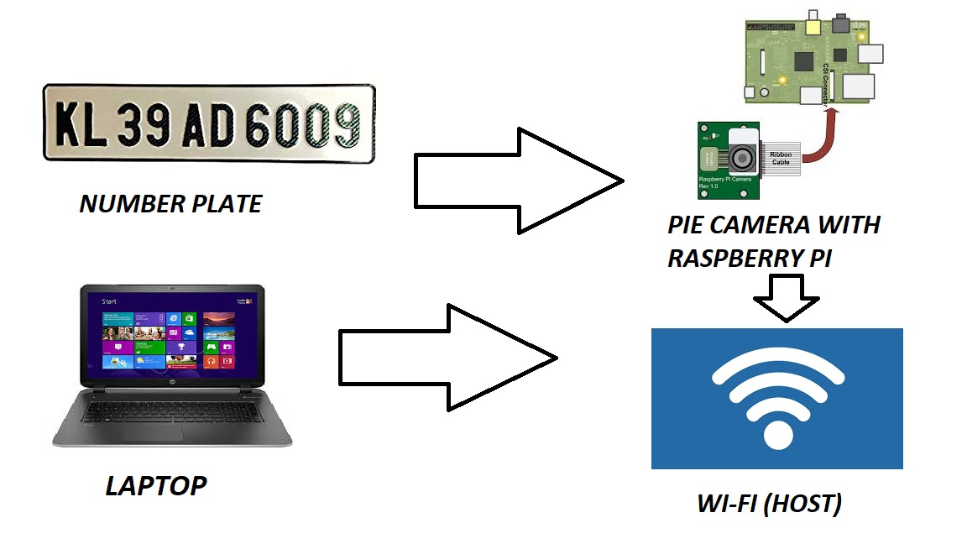
CIRCUIT DIAGRAM

Slide 7
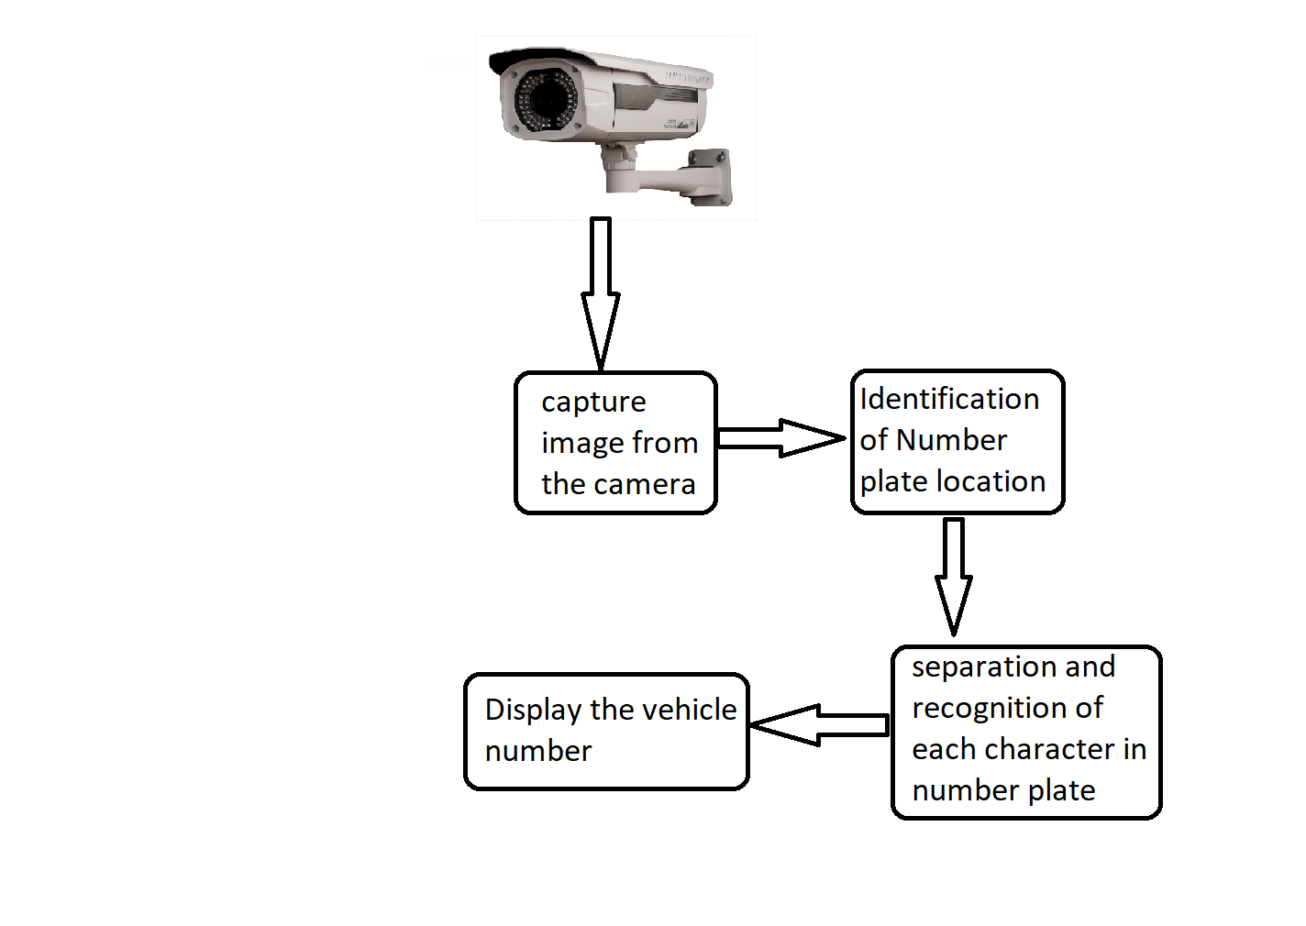
NUMBER PLATE RECOGNITION System

Slide 8
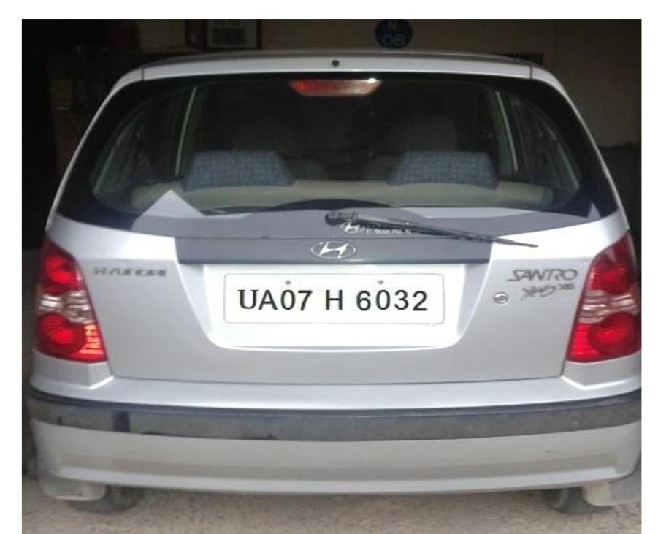
VEHICLE IMAGE CAPTURED FROM THE CAMERA
The image of the vehicle whose number plate is to be identified is captured using digital camera.

Slide 9
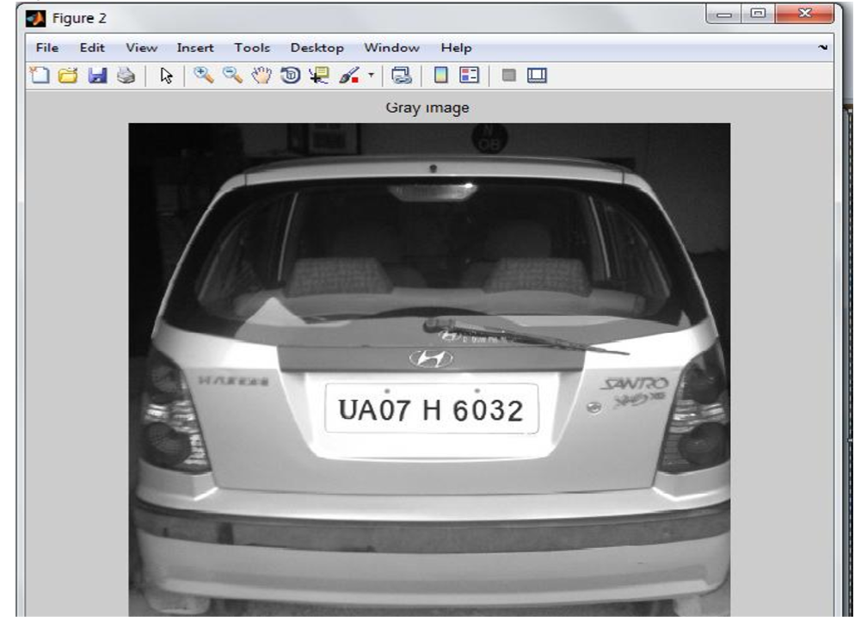
Extraction of number plate location
The inputs to the system were the images of vehicles captured by a camera. RGB to gray-scale conversion is adopted, in order to facilitate the plate extraction, and increase the processing speed. Colour image (RGB) acquired by a digital camera is converted to gray-scale image using I gray=0.114*r+0.587*g+0.299*b………(1)
In this step the number plate is extracted by firstly converting RGB Image i.e., the captured image to Gray Scale Image. Here mathematical morphology is used to detect the region and Sobel operator are used to calculate the threshold value. After this we get a dilated image. Then imfill function is used to fill the holes so that we get a clear binary image.

Slide 10
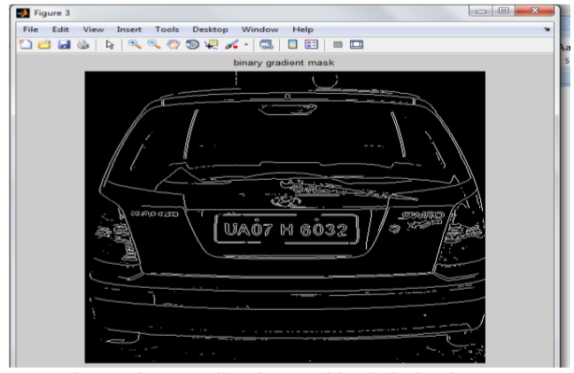
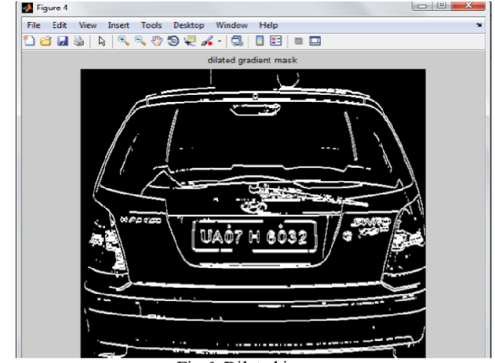
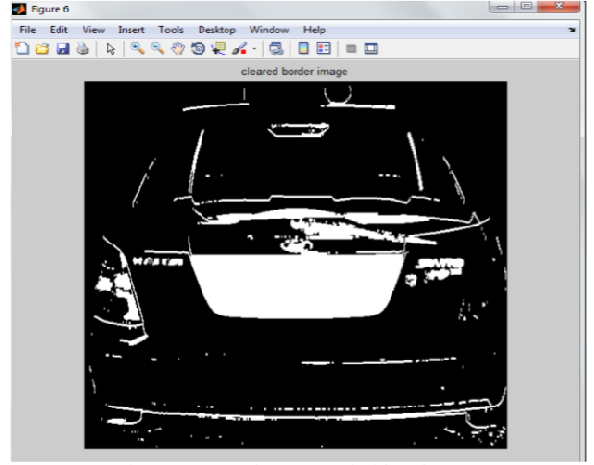
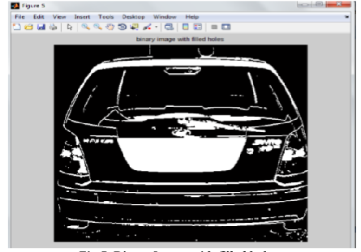
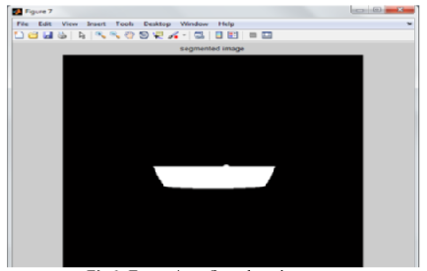
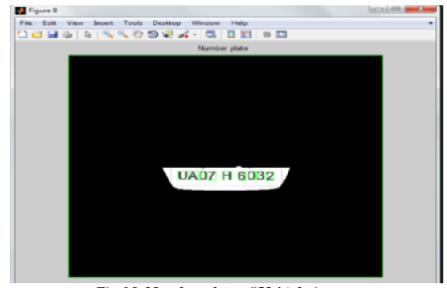

Slide 11
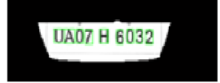
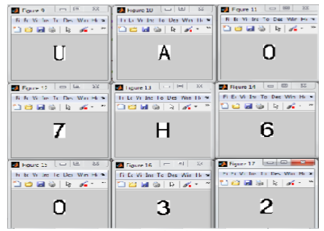
Character segmentation
Segmentation is one of the most important processes in the number plate recognition, because all further steps rely on it. If the segmentation fails, a character can be improperly divided into two pieces, or two characters. The ultimate solution on this problem is to use bounding box technique. The bounding box is used to measure the properties of the image region. Once a bounding box created over each character and numbers presented on number plate, each character & number is separate out for recognition of number plate The result of operation is shown in Fig.

Slide 12
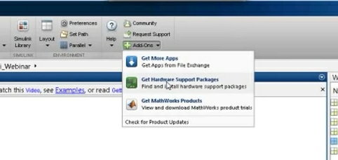
INTERFACING RASPBERRY PI WITH MATLAB
Install Support for Raspberry Pi Hardware Add support for Raspberry Pi hardware to the MATLAB product by installing the MATLAB Support Package for Raspberry Pi Hardware. This process installs the following items on your host computer: • Third-party software development tools • MATLAB commands • Examples This process also installs a customized version of Raspbian Linux® on the Raspberry Pi hardware. When you complete this installation, you can use MATLAB commands to control, and retrieve data from, Raspberry Pi hardware and peripherals. The Raspberry Pi hardware is also referred to as a board or as target hardware
Create Connection to One Board
Use the raspi function to create a connection to Raspberry Pi hardware and assign the connection
to a handle. Later, you can use the handle to interact with Raspberry Pi hardware and peripherals.
Using raspi without any inputs creates a connection to the Raspberry Pi that had the most recentsuccessful connection.
Supported peripherals
In this example:
• The raspi function uses the IP address, user name, and password from the most recent
connection to the Raspberry Pi hardware.
• The handle, mypi, displays properties from the Raspberry Pi hardware.
In MATLAB Online, using raspi with no inputs also connects to the Raspberry Pi that had the most
recent successful connection

Slide 13
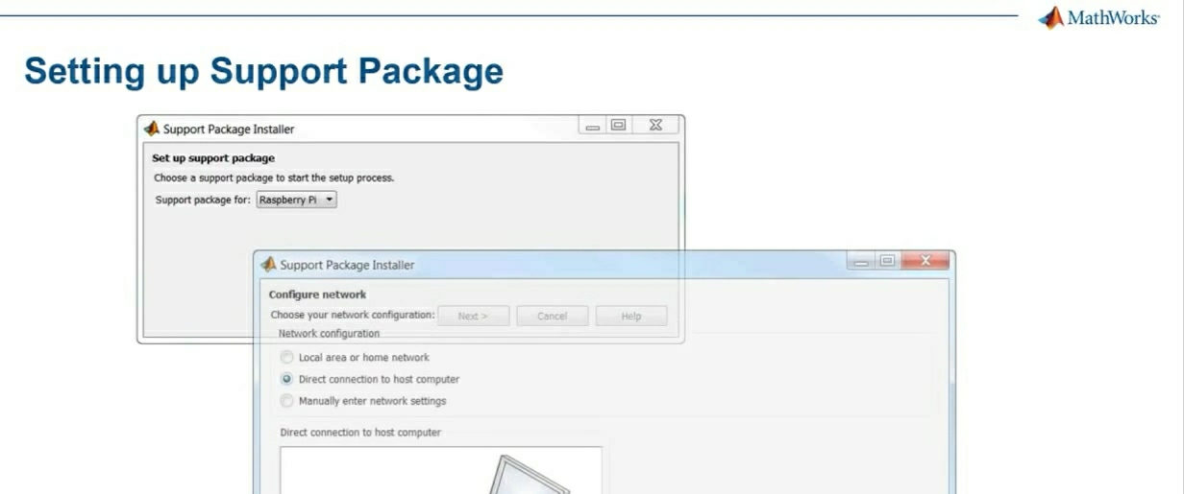
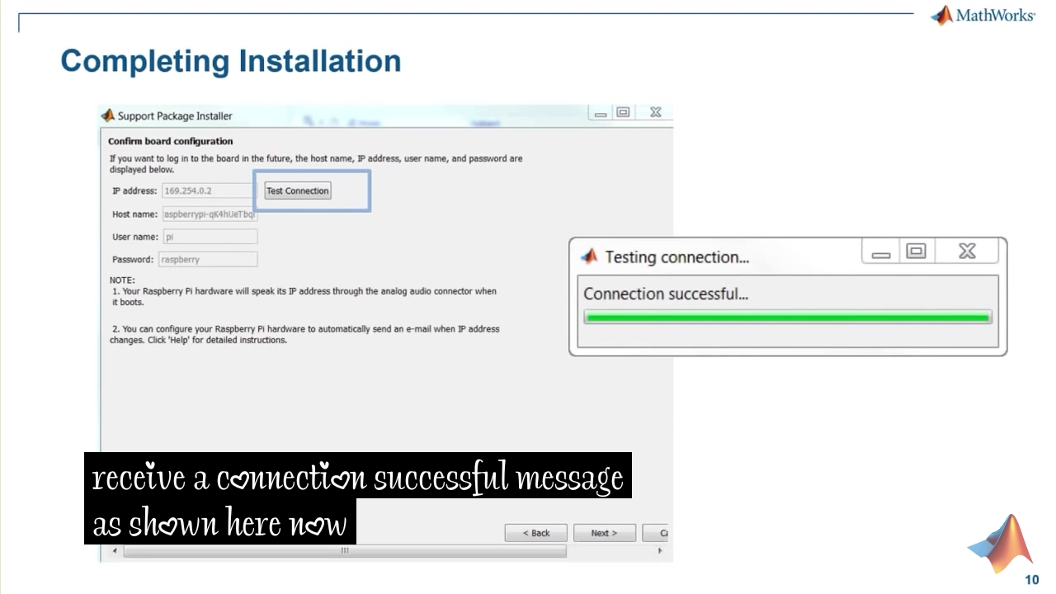
CONNECTING TO A STATIC HOST
Guidelines for Entering Static IP Settings
• The IP address must be unique for each device on the network.
• The Network mask must be the same for all devices on the network. This value is also known as
Subnet mask.
• The Default gateway is usually the same for all devices on the network.
Start by entering ipconfig at the command line of your host computer. This command displays
network settings of the Ethernet adapters on the host computer. Look for the settings of the Ethernet
adapter that is connected to the target hardware.
Suppose that the Ethernet adapter connected to the target hardware has the following values:
IPv4 Address. . . . . . . . . . . : 192.168.1.2
Subnet Mask . . . . . . . . . . . : 255.255.255.0
Default Gateway . . . . . . . . . : 192.168.1.1
In that case, for the target hardware:
• Set IP address to an unused IP address, between 192.168.1.3 and 192.168.1.254
• Set Network mask to use the same network mask value, 255.255.255.0

Slide 14
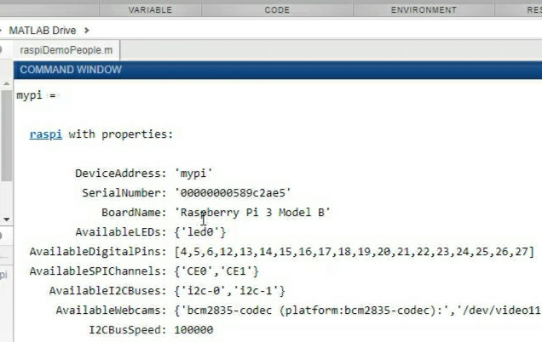
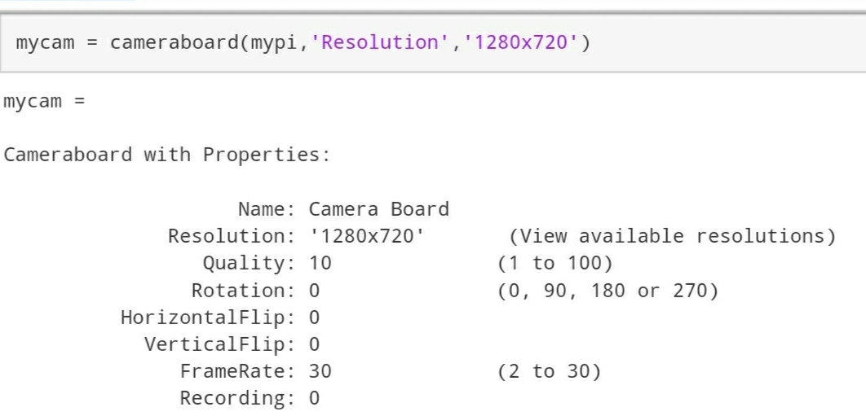
CONFIGURING RASPBERRY PI AND PI CEMARA
Use the following commands to configure the raspberry pi to work with MATLAB.
mypi = raspi(ipaddress,username,password)
Use the following command to configure
pi cemara to control with MATLAB.
mycam = cameraboard(mypi,'Resolution','1280x720')
this commands will show command line output as shown in fig

Slide 15
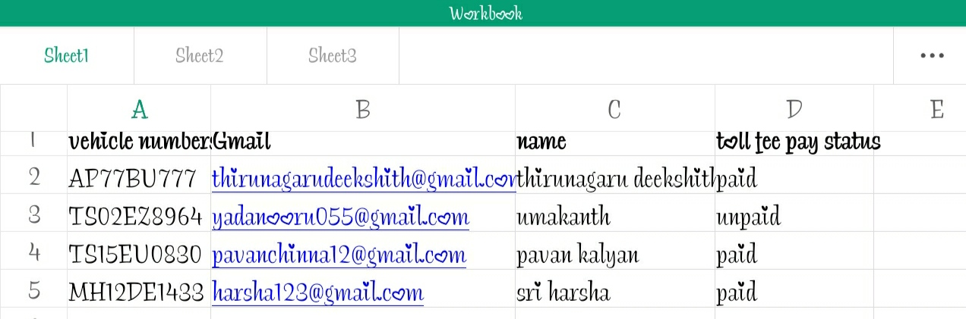
DATA HANDLING WITH MATLAB
After obtaing the vehicle number from NPR system, that vehicle number needs to be compared with the data base in exel sheet to know neccesary details.
this can be performed by the MATLAB with file handling techniques used in souce code.

Slide 16
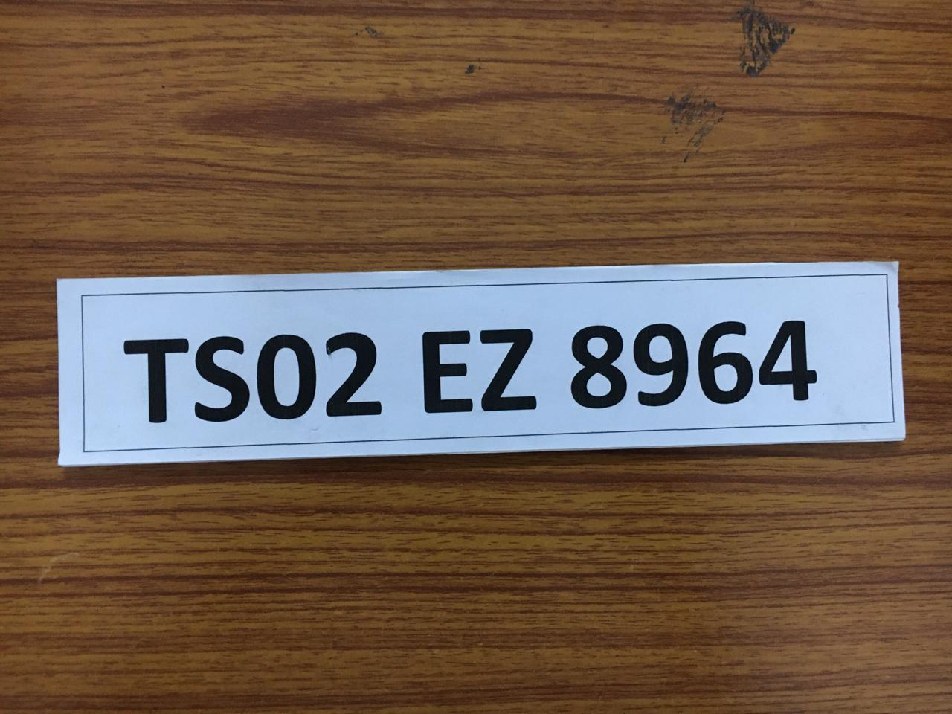
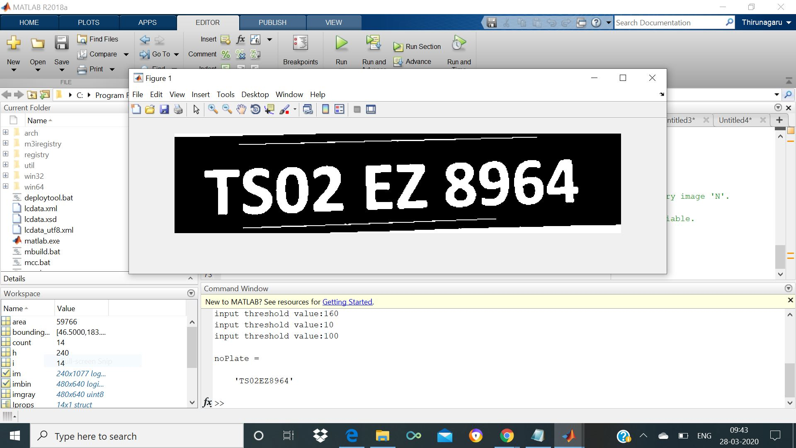
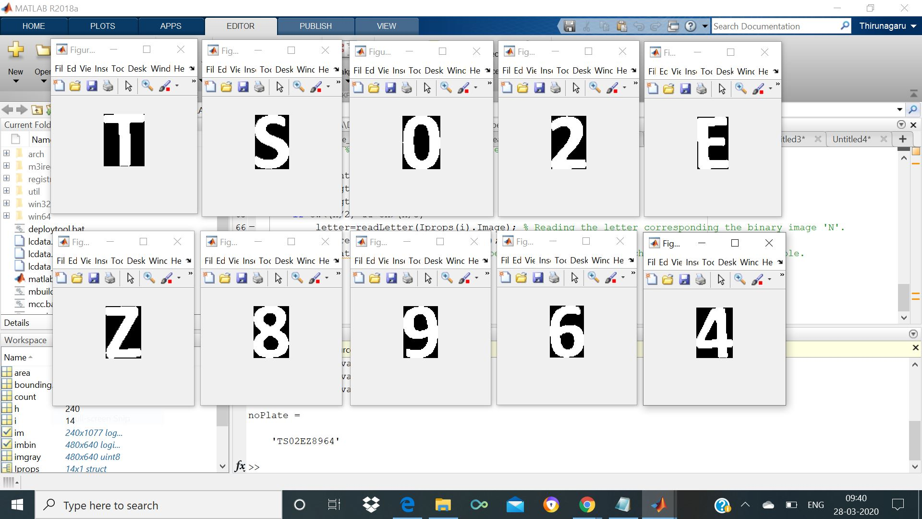
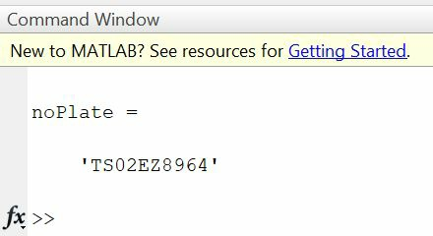
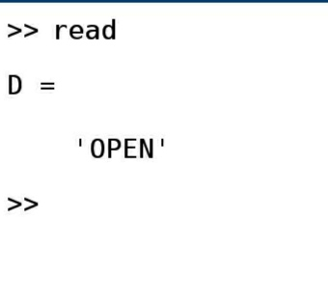
RESULT
The output from the NPR technique used in source code in MATLAB from the image captured is as shown in this figures.
Final output for toll gate to open.

Slide 17
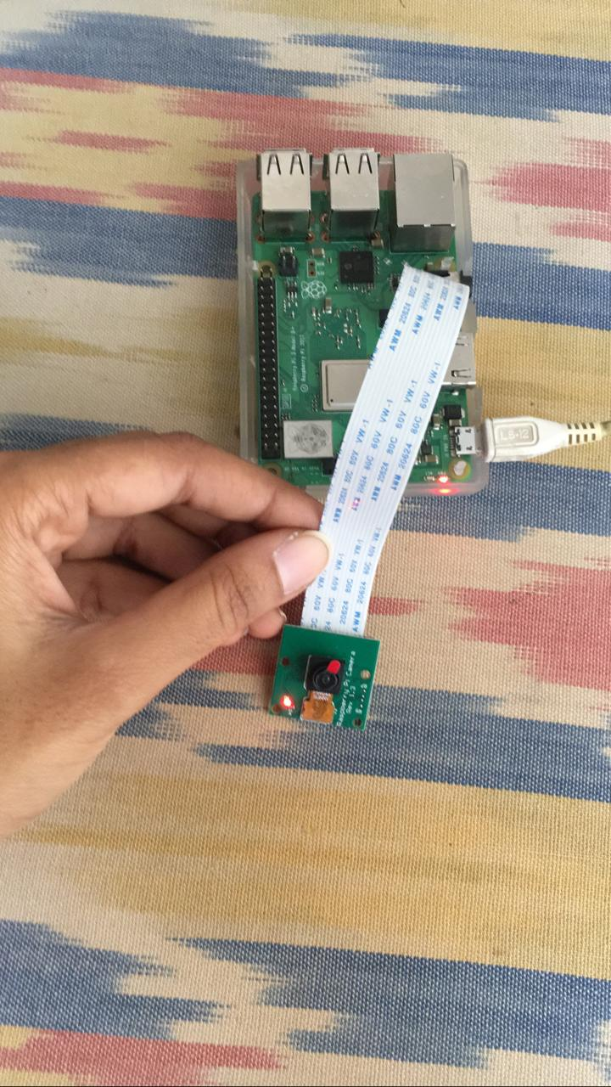
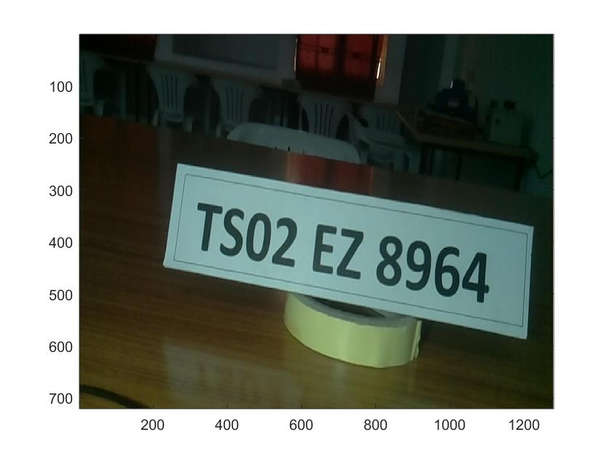
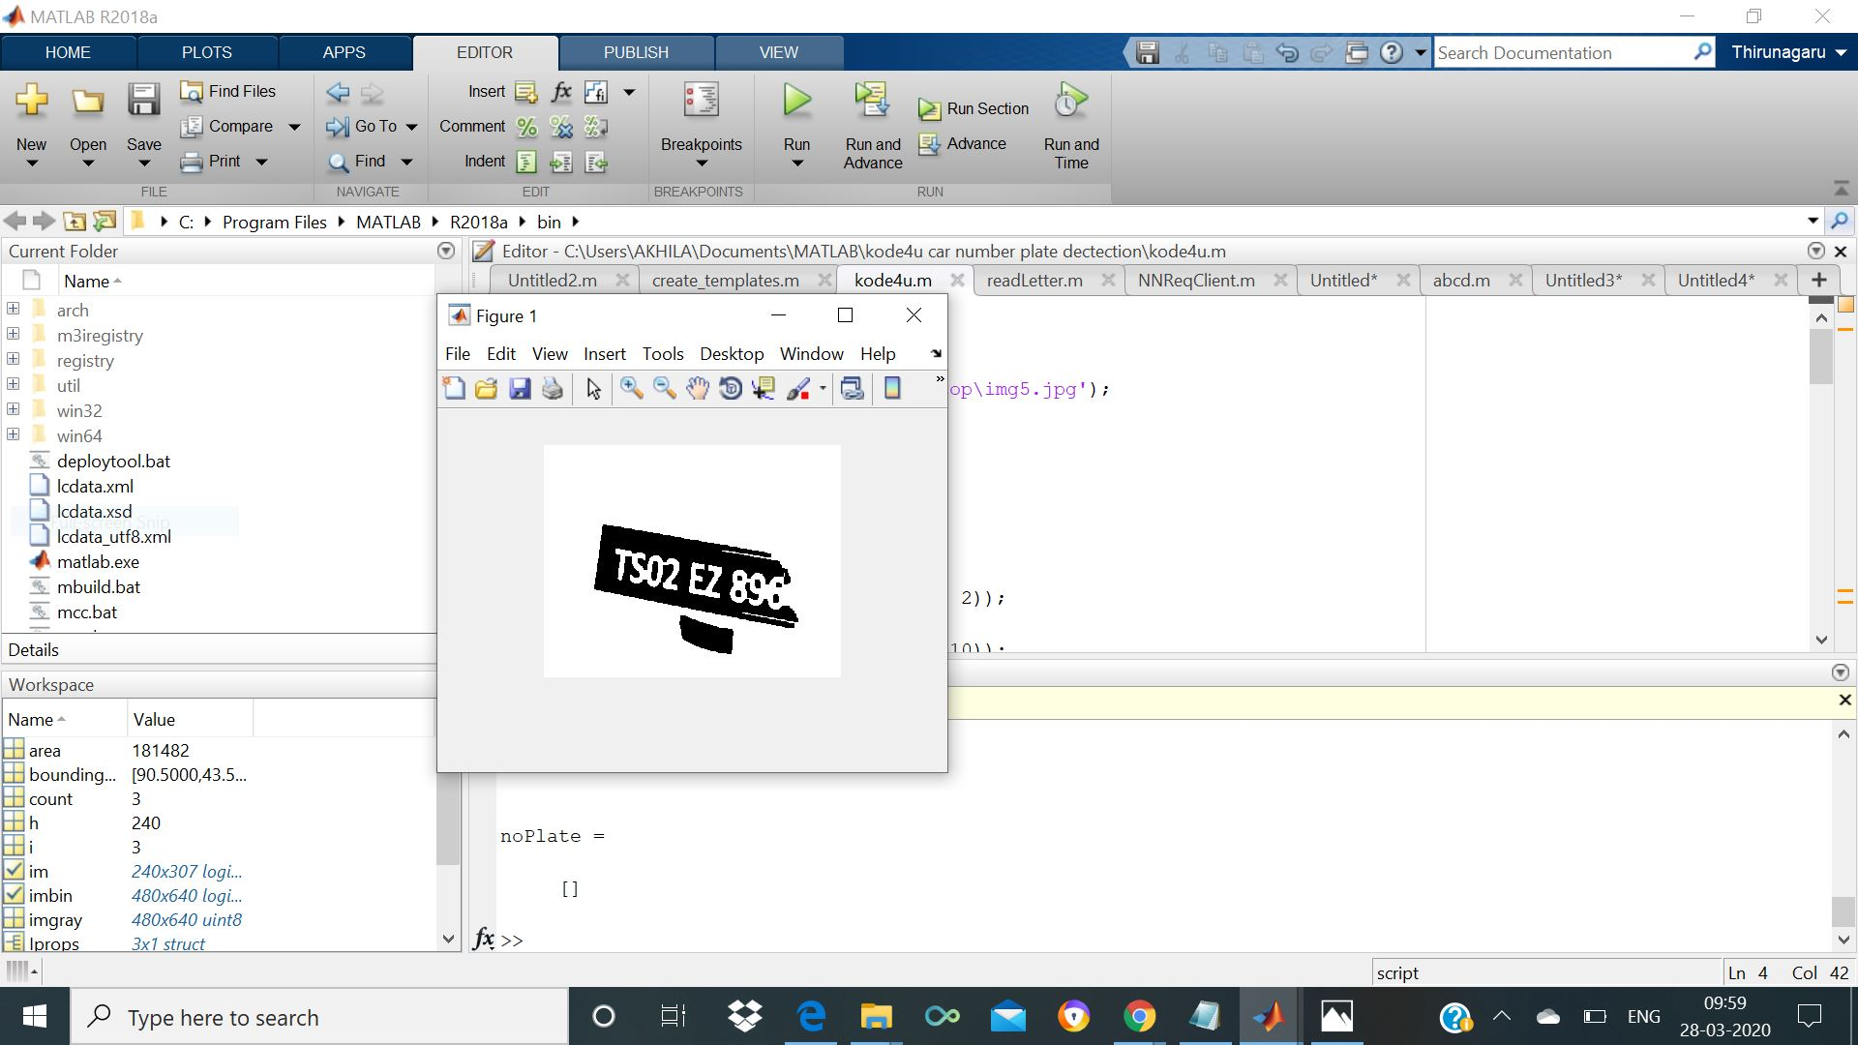
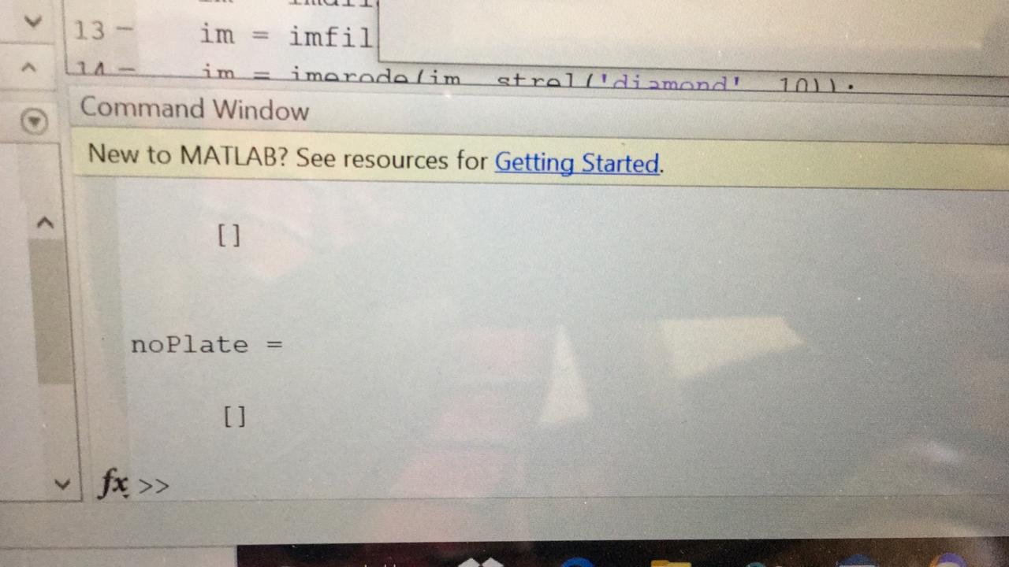
STATUS USING RASPBERRY PI CEMARA
After successfully interfacing raspberry pi and pi cemara with MATLAB, following fig shows setup as well as obtained output images
Complete raspberry pi setup with pi cemara connected
Given image from raspberry pi to the MATLAB for processing.
Command prompt showing no errors and empty noPlate
Processed image output from the source code for the image captured from pi cemara

Slide 18
applications
This project can be used at the passage for security control of a profoundly confined region like military zones or region around top government workplaces for example parliament, Supreme Court and so forth.,
This project can be used by traffic police to punish the traffic rule breakers by sending challan to their home automatically.
This project is useful at the entrances of apartments to open the gates automatically when the owners vehicle at the entrance.

Slide 19
Thank you

